Slide 1

Case Study: HR Analytics
Exploratory Data Analysis and Predictive Modeling for Candidate Joining Prediction in Talent Acquisition
Prepared by:
Rohan Harichandan
Roshan Panigrahi
Shubham Kumar
Nischay Singh
Biswojit Palai
Arnab Roy

Slide 2
BUSINESS PROBLEM
HRWorks Pvt Ltd, a talent acquisition solution organization, faces the challenge of a
significant proposition of candidates not joining the company after accepting job offers.
this leads to loss of revenue and resources as the recruitment process must be restarted.
The objective of this project is to build a predictive model to classify whether a candidate
will join or not, aiding in identifying candidates who are more likely to join and mitigating
the loss caused by attrition.

Slide 3
Feature | Description
Sno: | Sl number auto increment
Candidate_Ref: | Candidate reference number
DOJ_Extended: | Date of Joining of extended
Duration_to_accept offer: | Duration to accept the offer by candidate
Notice_Period: | Notice period of previous employer
Offered_Band: | E1 < E2 < E3 and so on
Percent_hike_expected_in_CTC: | expected hike by candidate
Percent_hike_offered_in_CTC: | hike offered by joining organization
Percent_difference_CTC: | difference between expected and offered
Joining_Bonus: | any joining bonus offered
Candidate_relocate_actual: | relocating required or not
Gender: | Gender of candidate
Candidate_Source: | How candidate applied or reached
Rex_in_Yrs: | years of exp
Location_ID: | Code for current location of organisation
Postal_Code: | Postal Code of the area of organisation

Slide 4
Feature | Description
Domicile_Id: | Code for home state of the candidate
Region_Code: | Code representing unique Region name
Age : | Age of candidate
LOB: | Line of business
Date_of_Interview : | Date on which Interview was conducted.
LOB_id: | Unique id for Line of Business(LOB)

Slide 5
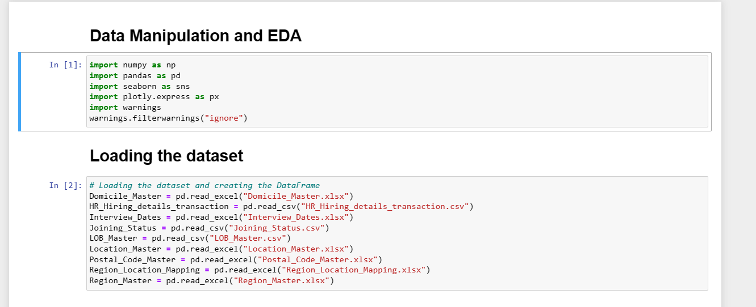
Data Manipulation and EDA

Slide 6
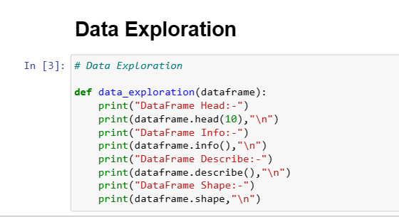
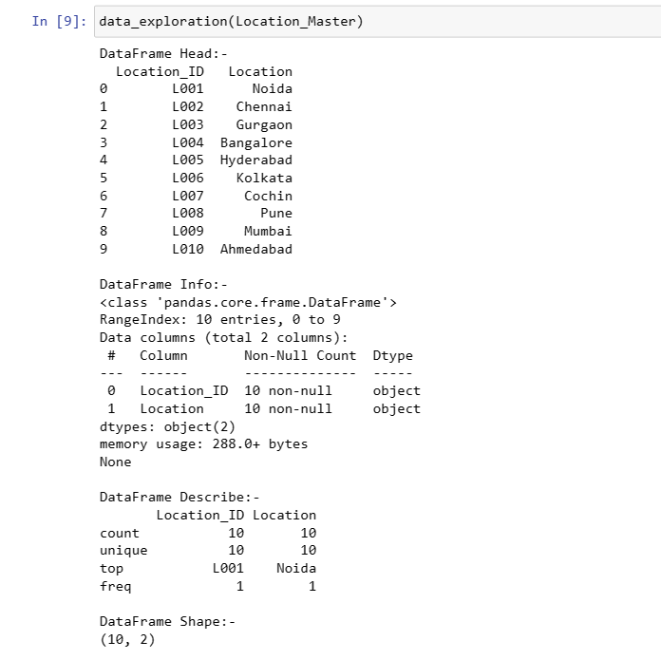
DATA EXPLORATION
(Getting insights)

Slide 7
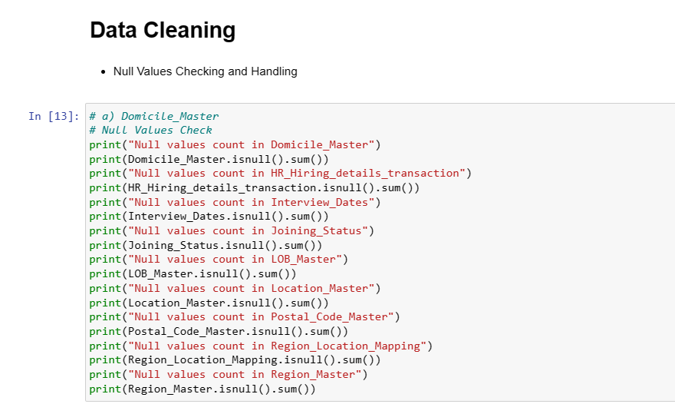

Slide 8
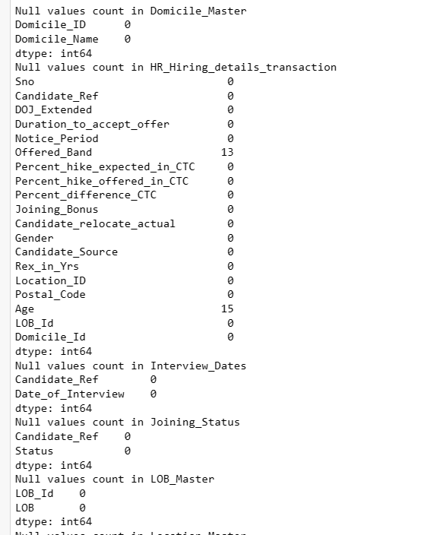
OUTPUT (example)

Slide 9
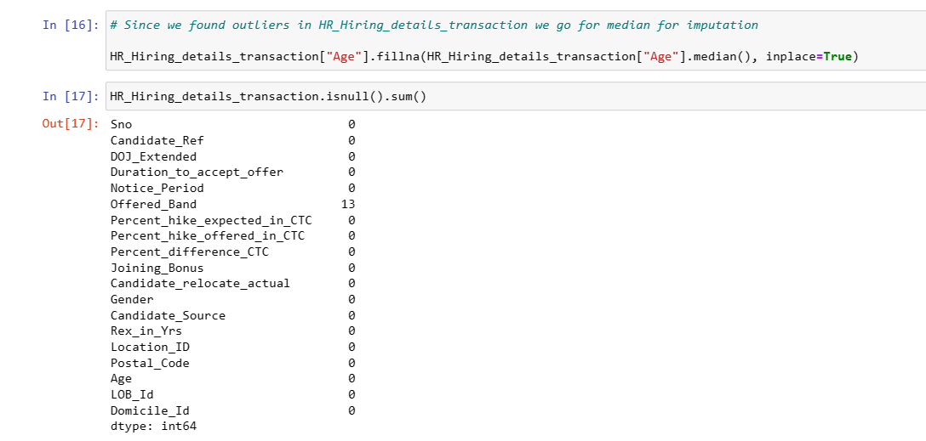
Filling null value in Age with median

Slide 10
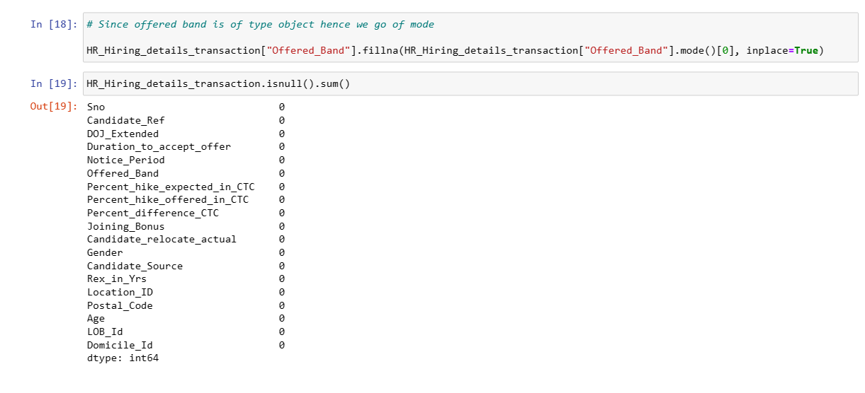

Slide 11
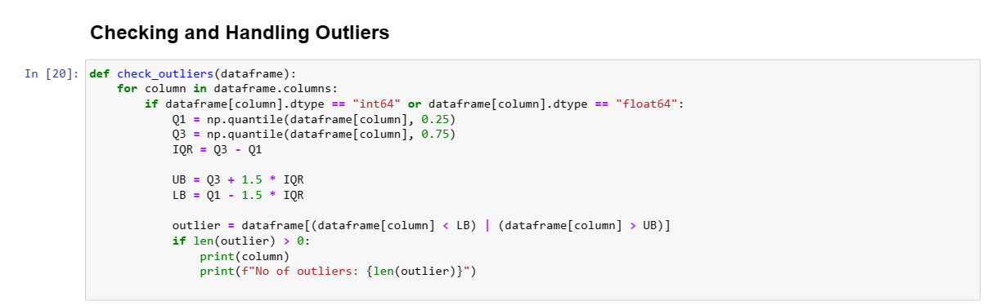
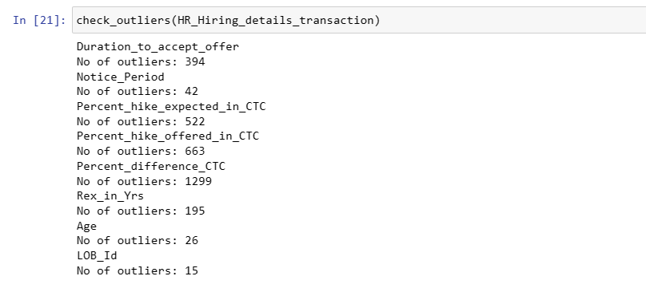

Slide 12
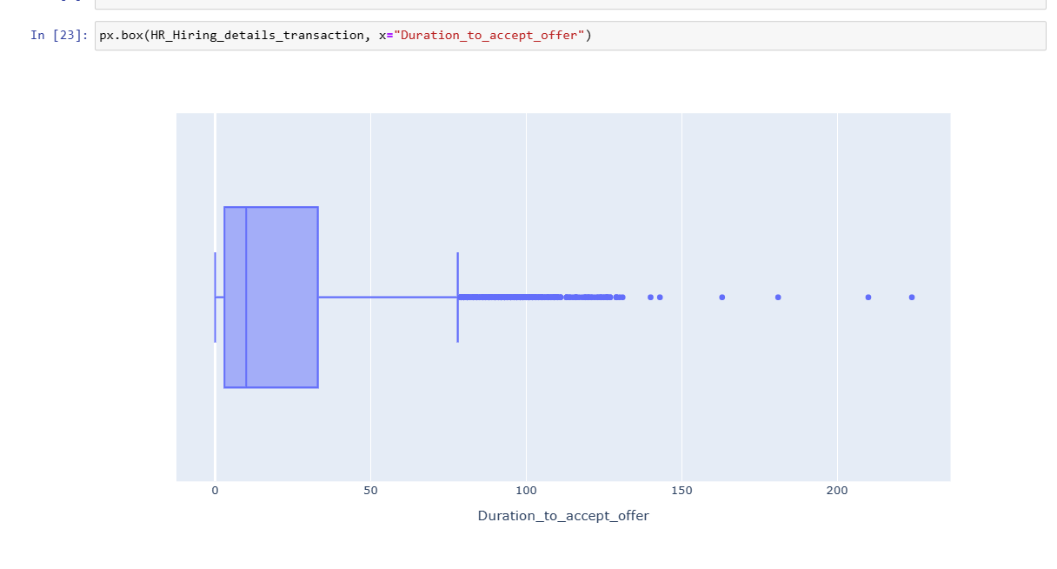
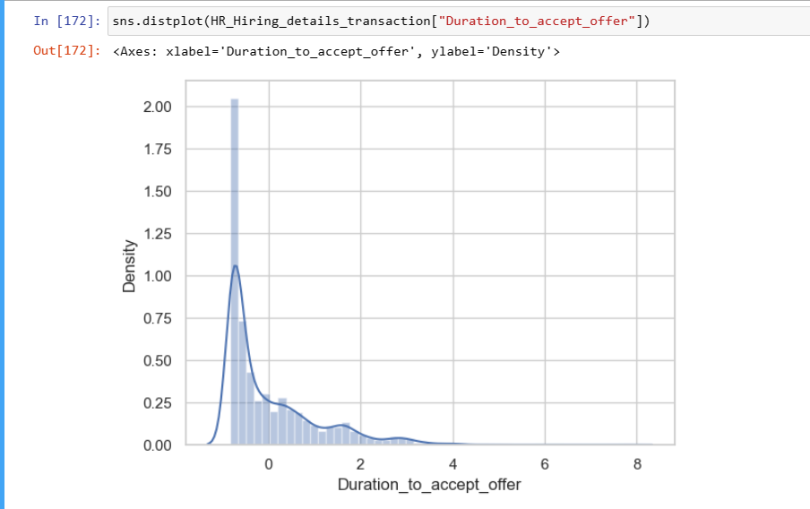

Slide 13
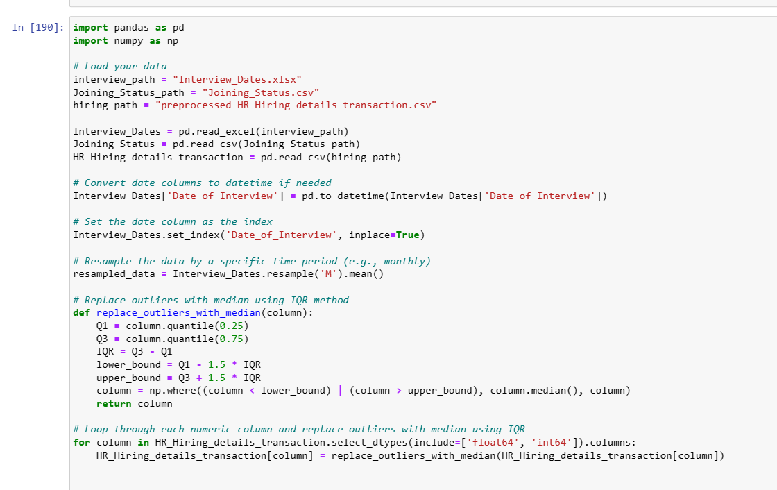

Slide 14
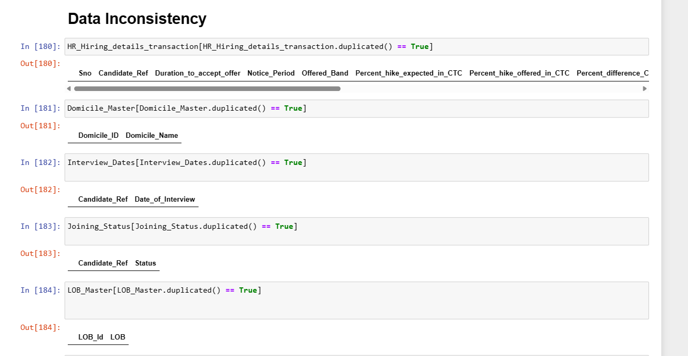

Slide 15
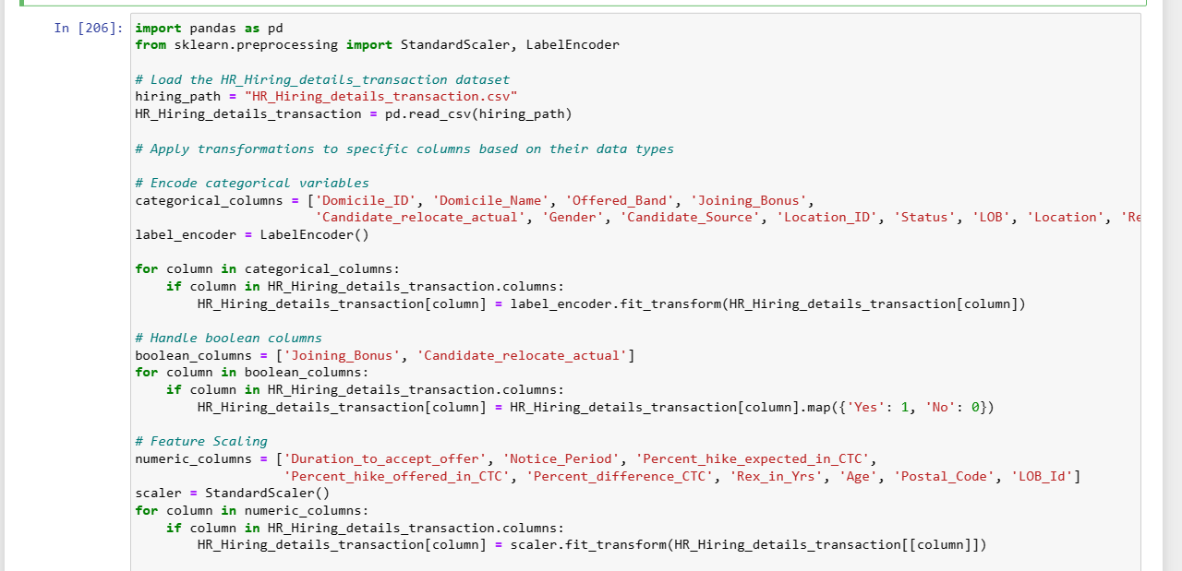
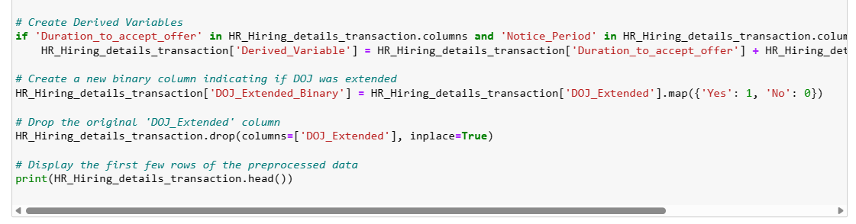
Data Transformation
Feature Engineering (Categorical to numerical transformation)

Slide 16
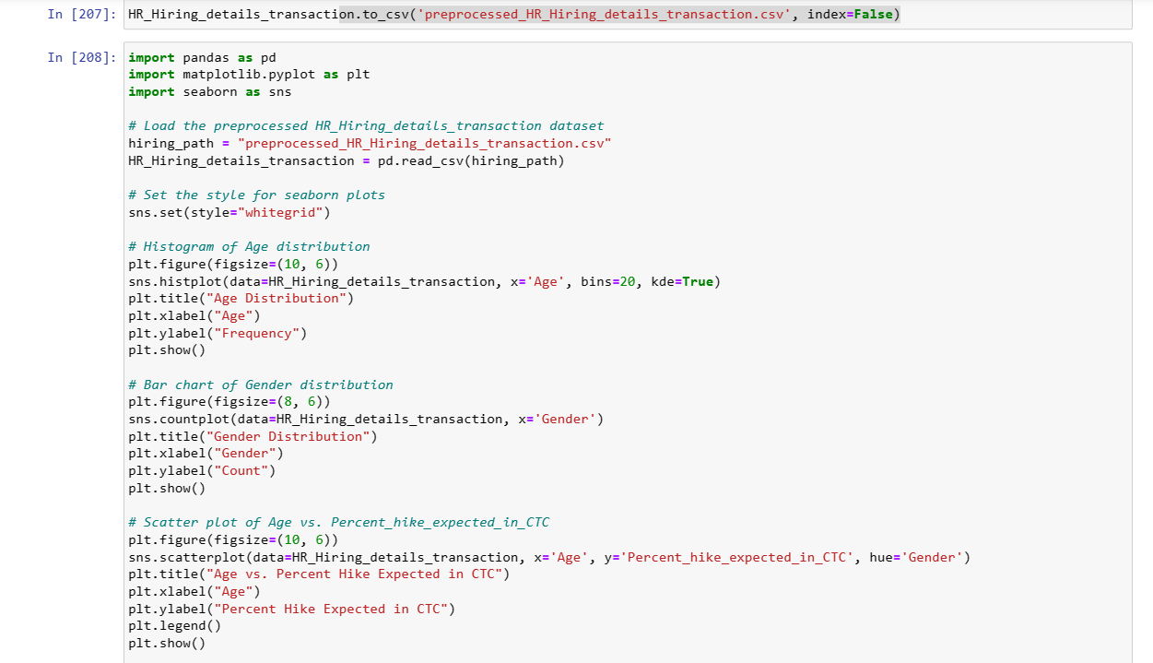

Slide 17
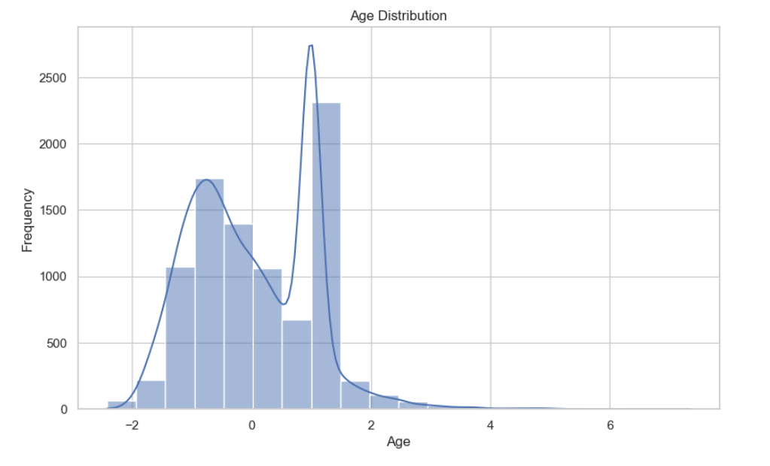
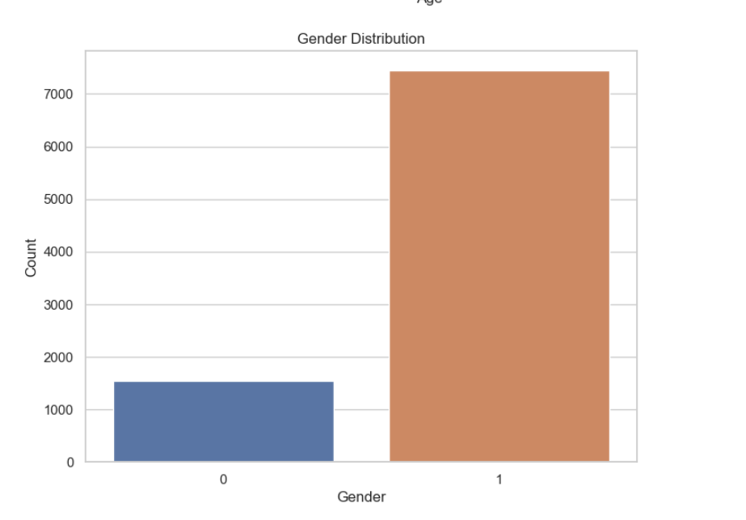

Slide 18
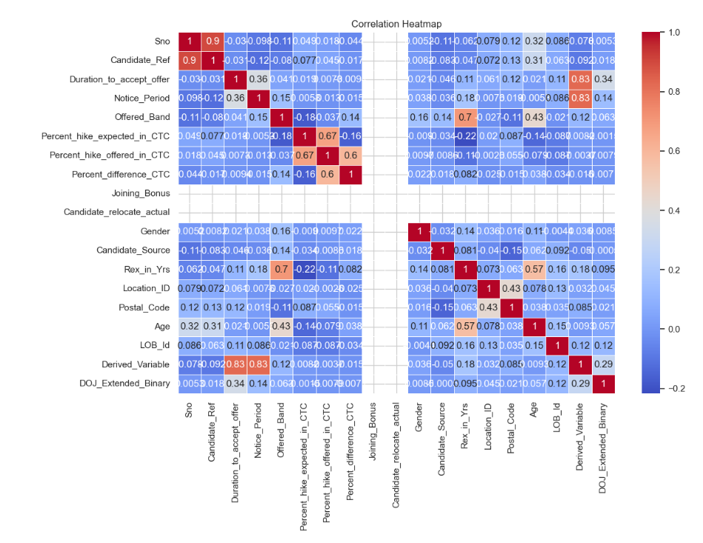

Slide 19
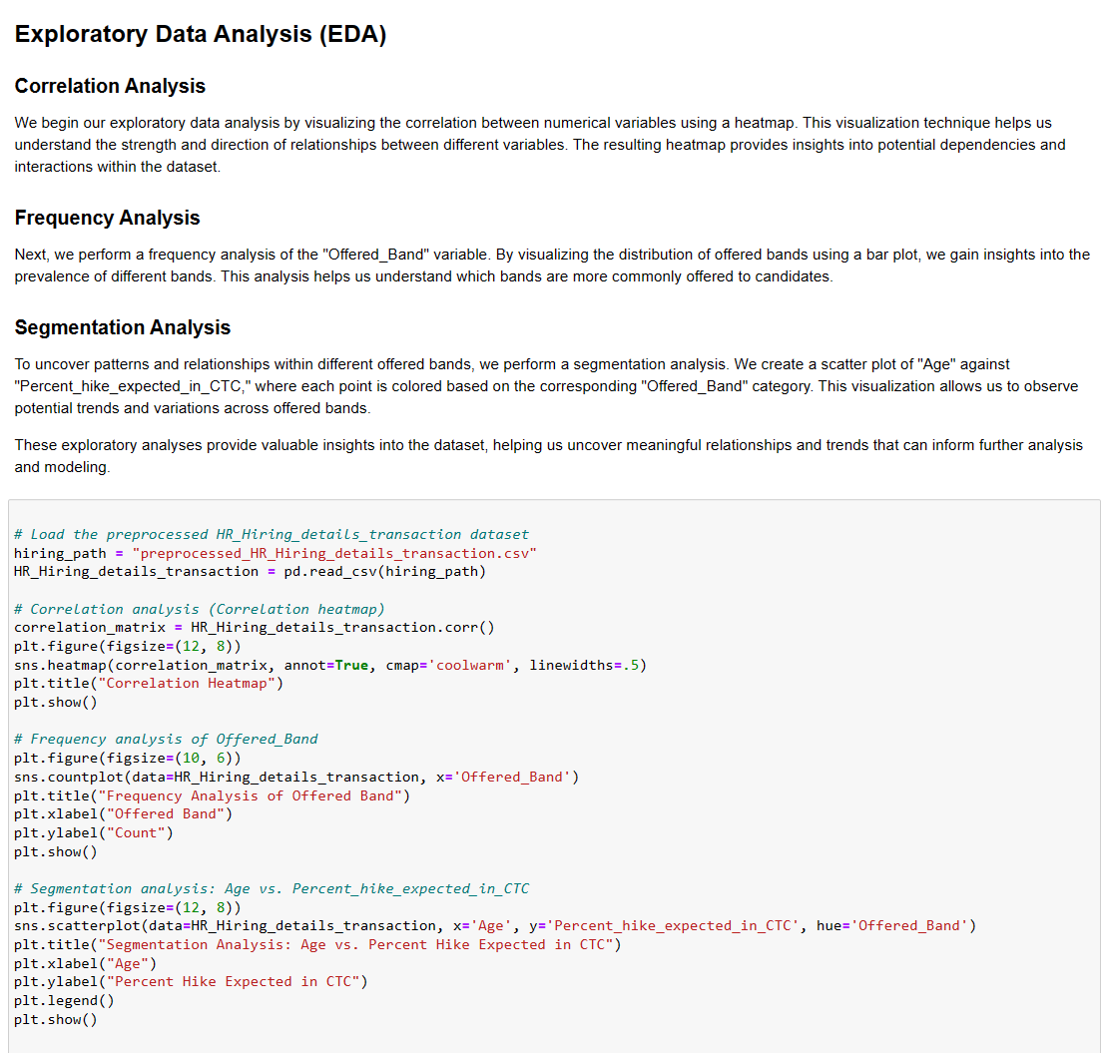

Slide 20
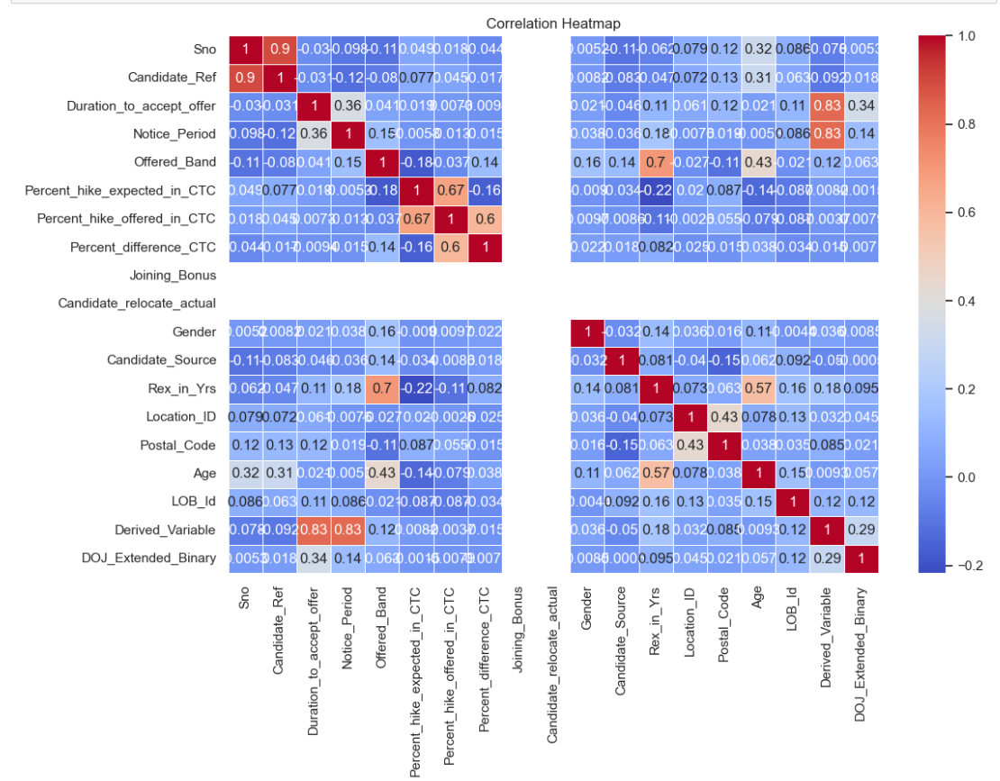

Slide 21
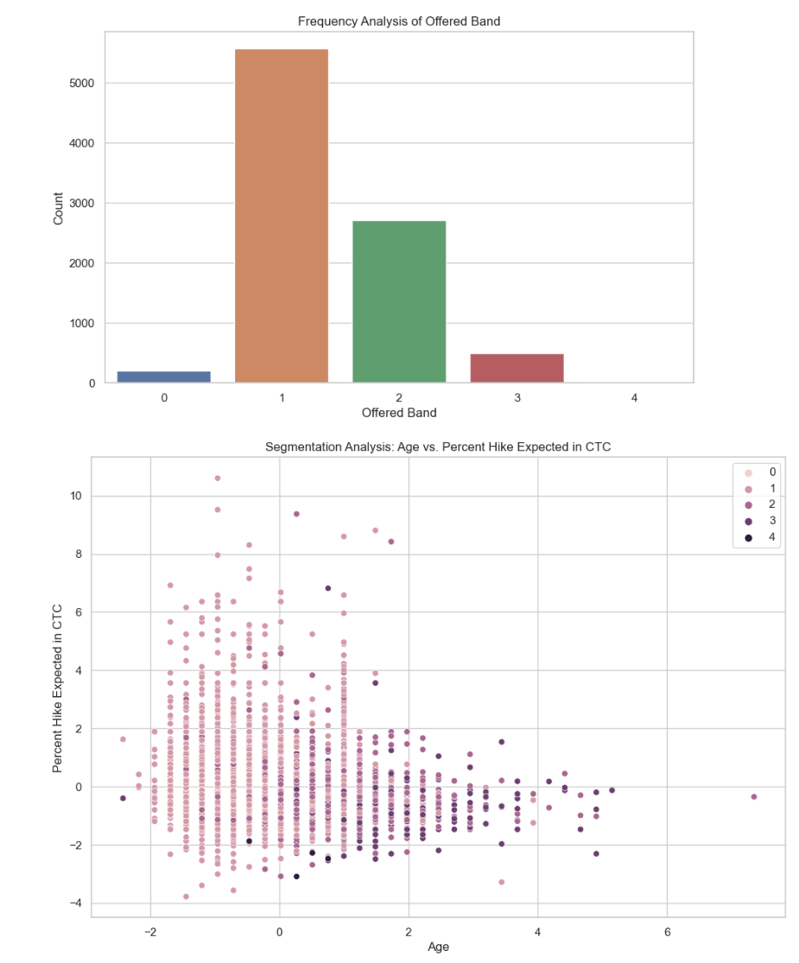

Slide 22
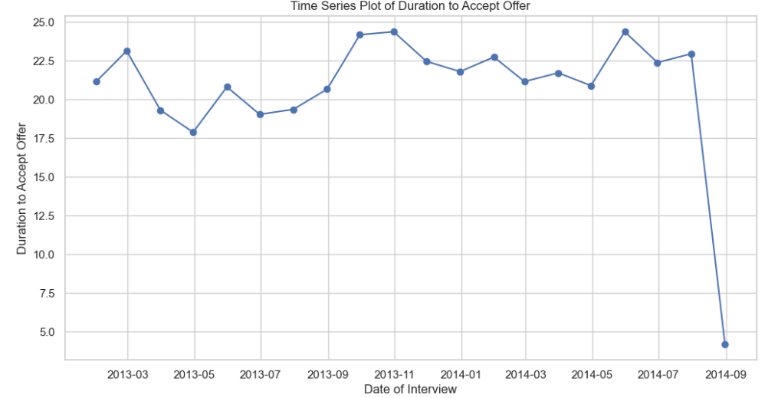
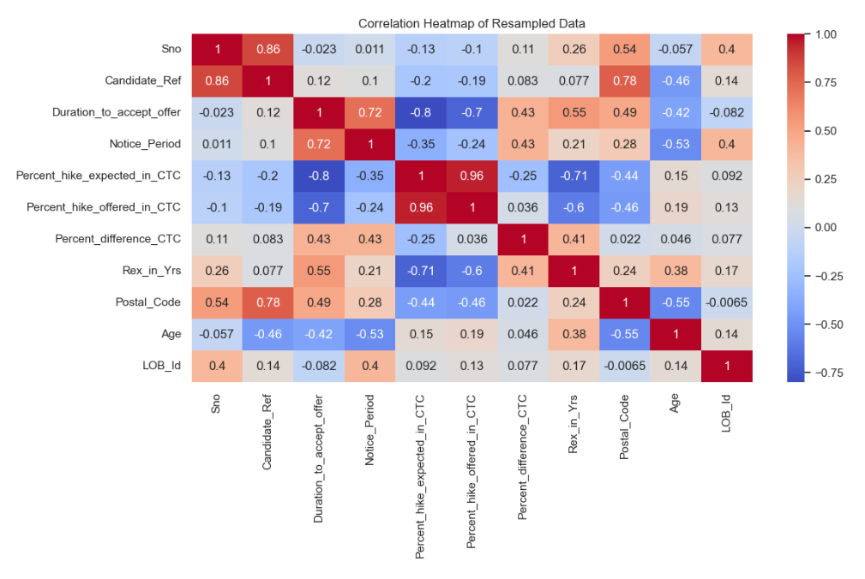

Slide 23
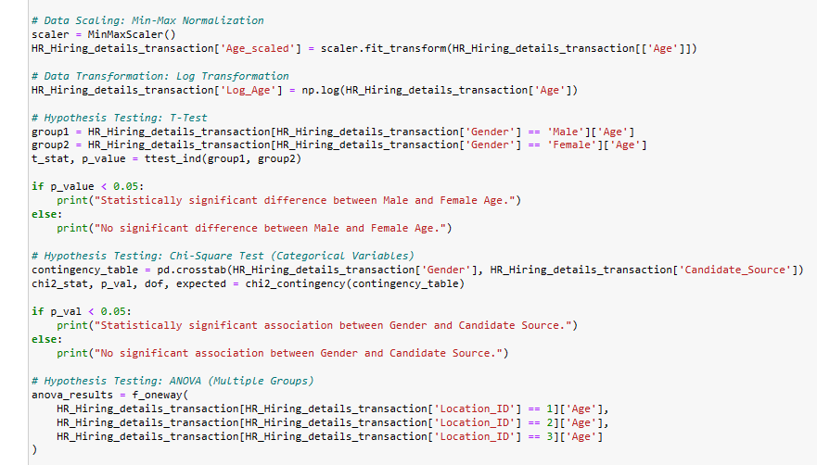

Slide 24
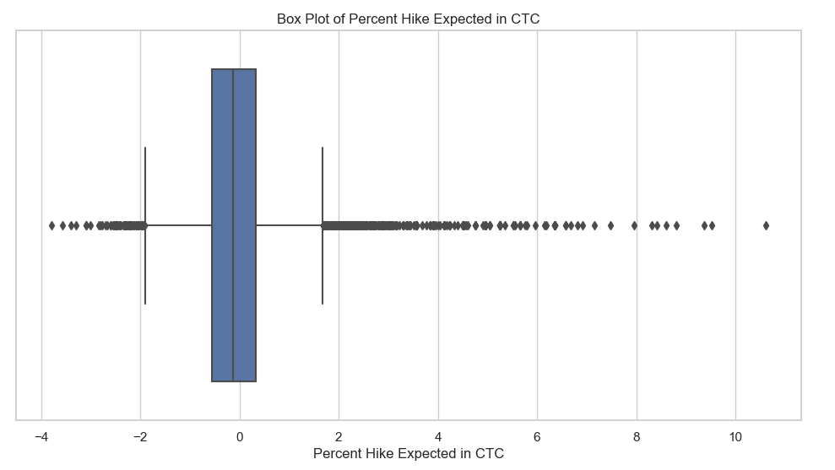
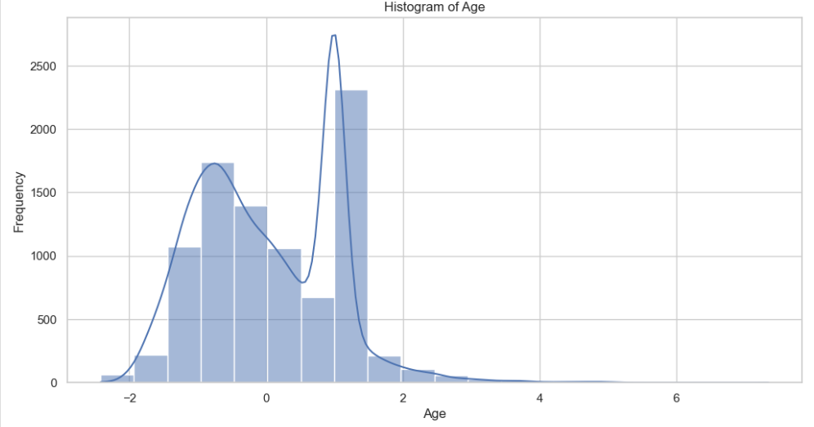
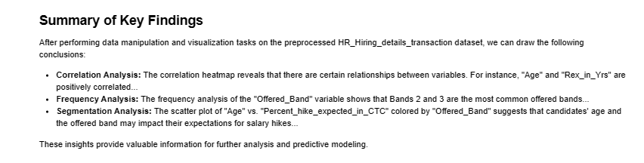

Slide 25
Data Visualization using Power BI
Introduction to Power BI
How our project is related to power BI?
By using Power BI in this project, the HRWorks Pvt Ltd can gain a comprehensive understanding of candidate joining patterns, identify factors influencing joining decisions, and make data-driven decisions to optimize the talent acquisition process. The interactive and visually appealing Power BI dashboard ensures that the insights are presented in an engaging and accessible manner, promoting effective data analysis and informed decision-making across the organization.

Slide 26
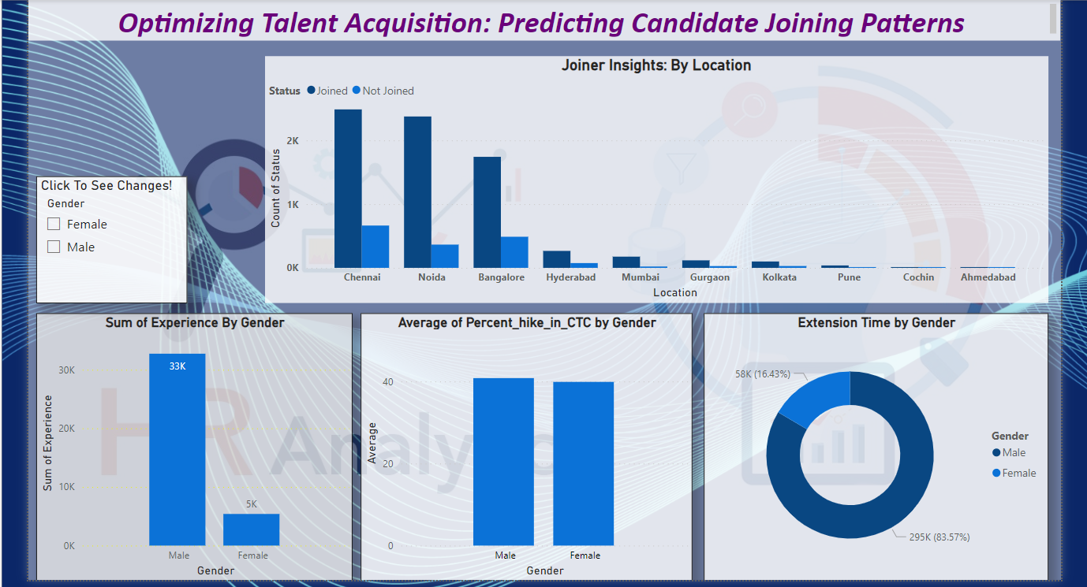
Power BI Dashboard

Slide 27
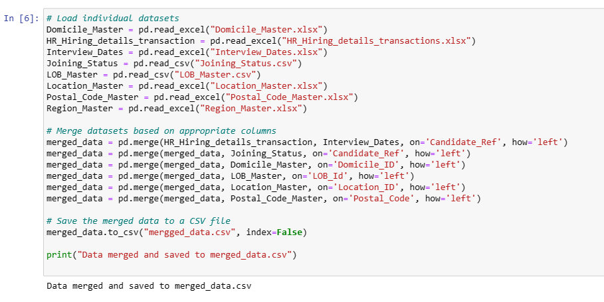
ML MODEL

Slide 28
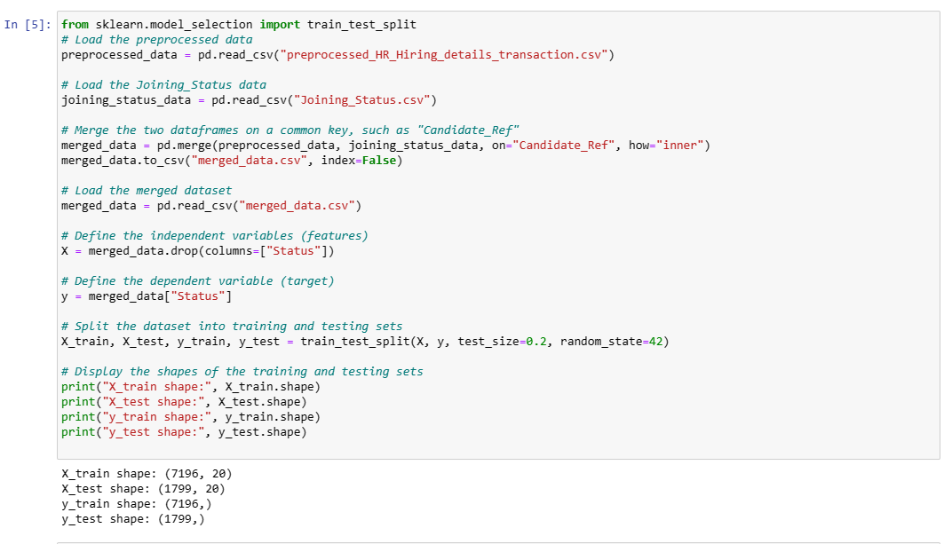
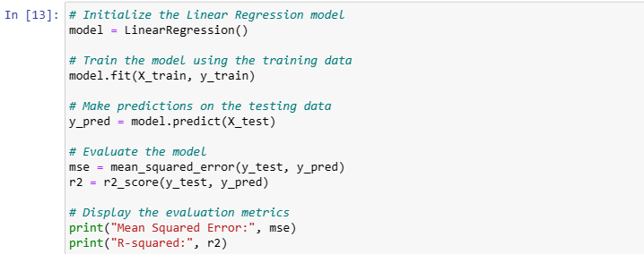

Slide 29
Conclusion
The HR Analytics project aimed to optimize the talent acquisition process and enhance HR decision-making through data-driven insights. The project began with exploratory data analysis (EDA) to understand candidate joining patterns, identify influential factors, and address data quality issues. Descriptive analysis highlighted key outcomes and provided a comprehensive understanding of candidate joining behavior.Through data preprocessing, missing values were handled, categorical variables encoded, and feature engineering performed to prepare the data for modeling. Various machine learning algorithms, such as logistic regression, decision trees, random forests, and gradient boosting, were employed to predict candidate joining status.The results revealed valuable insights. The gender with the highest average percent hike in CTC was identified, aiding in salary negotiation strategies. Additionally, the location witnessing the highest number of joiners was recognized, leading to targeted recruitment efforts in high-demand regions.The Power BI dashboard further enriched the analysis, offering interactive visualizations to explore the dataset. KPIs, cross-filtering, and slicing functionalities enabled dynamic data exploration. The dashboard's storytelling elements facilitated clear communication of findings and guided stakeholders through the insights derived from the data.The predictive models provided accurate and reliable candidate joining predictions, enabling HRWorks Pvt Ltd to identify candidates more likely to join and mitigate attrition-related losses. Leveraging these models, HRWorks Pvt Ltd can optimize the talent acquisition process and make well-informed decisions to attract and retain top talent effectively.In conclusion, this HR Analytics project successfully harnessed data analysis and predictive modeling techniques to revolutionize talent acquisition practices, enhance decision-making, and drive the organization's success in the competitive job market. The implementation of data-driven strategies empowers HRWorks Pvt Ltd to build a stronger and more committed workforce, ensuring sustained growth and profitability in the long run.

